Slide 1
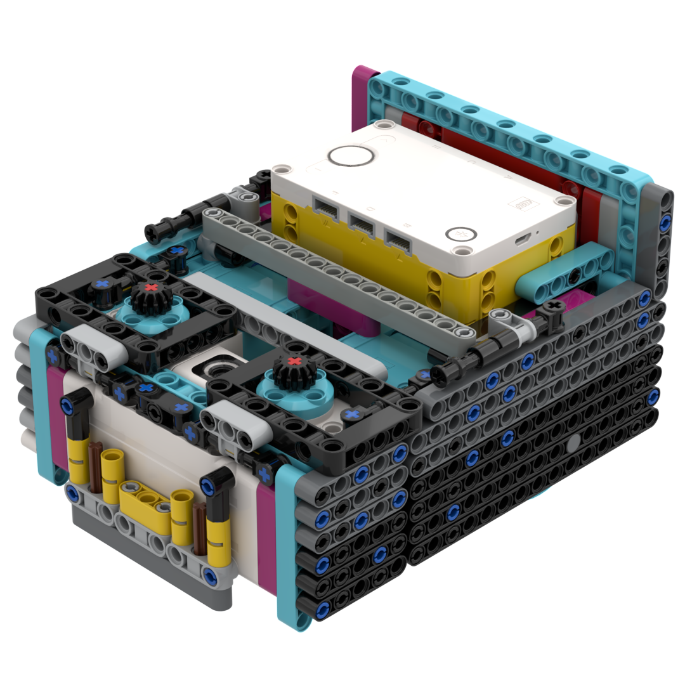
Our Robot:
Enrique
First Lego League Submerged
2025
Blarney Brickbusters Present

Slide 2
Mission Strategy
Collect Krill / Coral
Don’t waste runs
Quality over Quantity
We wanted to collect these as they would be in the way when completing other missions
Avoid driving directly from home to home without doing missions as this wastes valuable time
We struggled with accuracy last year so we wanted to make sure all runs worked consistently
Remote Control
Passive Attachments
Submarine
Use remote to test and code missions so we can be faster and more efficient
Try use passive attachments where possible for consistency and ease of coding
Submarine needs to be on the opponent's side to score extra points, so we tried to finish with it

Slide 3




Coding Process
PLAN
BUILD
DRIVE
ADJUST
Plan what missions to do in the run and in what order
Build attachments to complete each mission
Use remote control to drive robot and get measurements for code
Adjust the code to ensure it works more consistently

Slide 4

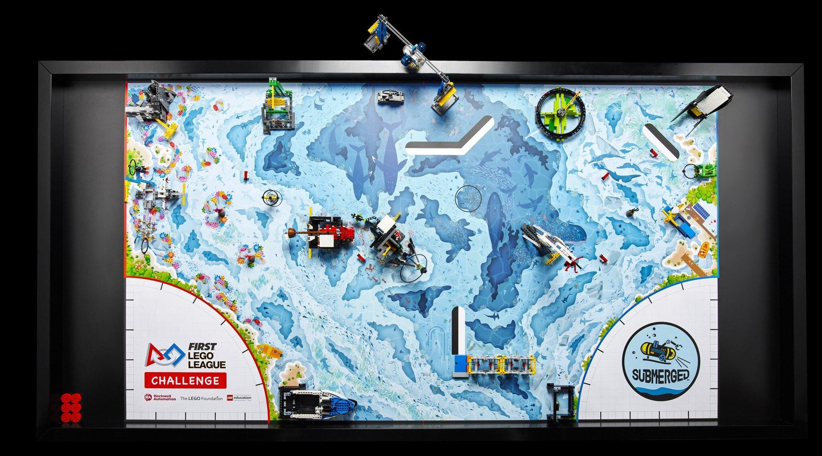
Plan
Plan what missions to do in the run and in what order
4 things taken into account:
How difficult is a mission
Where is the mission located in relation to others we want to do
If mission can be solved with a similar attachment to other missions
What side of the board robot will be at and where it needs to go
We then discuss possible routes to take and test drive them using our remote control

Slide 5

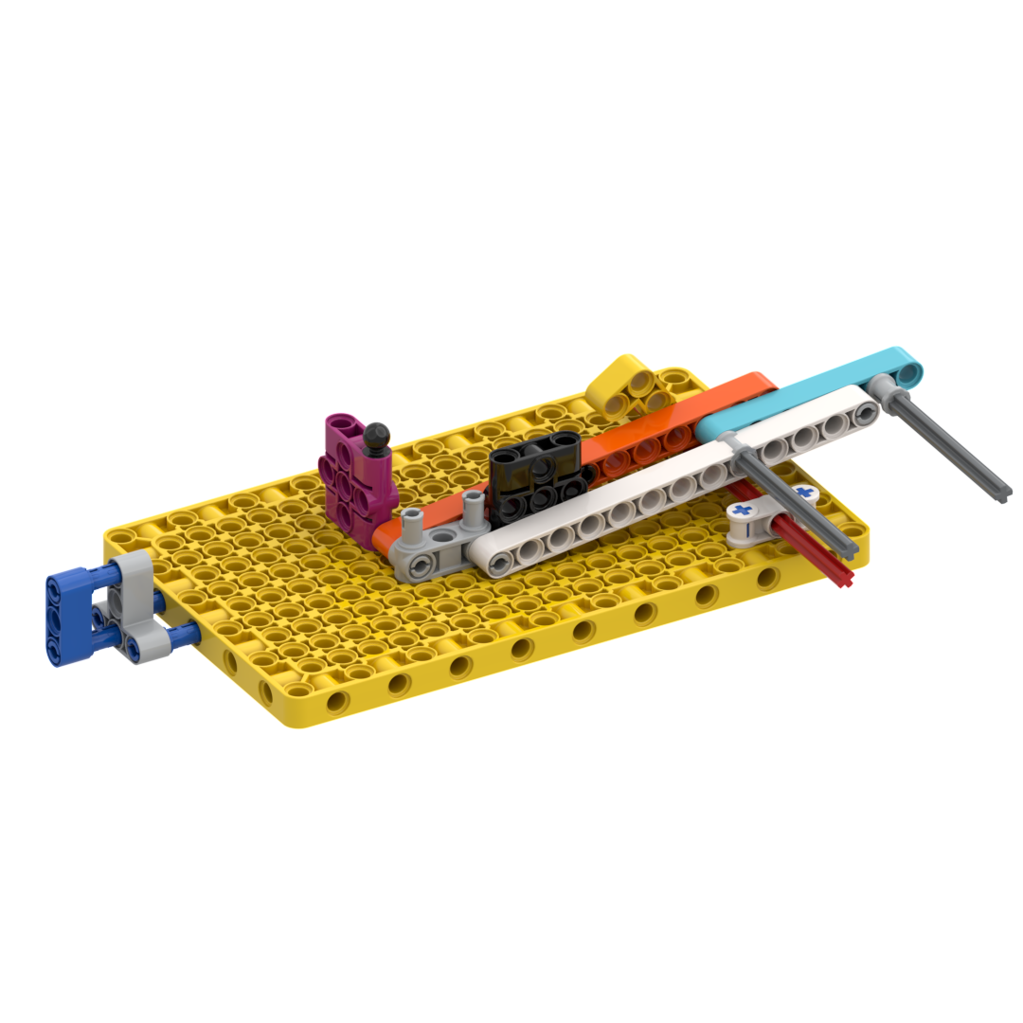
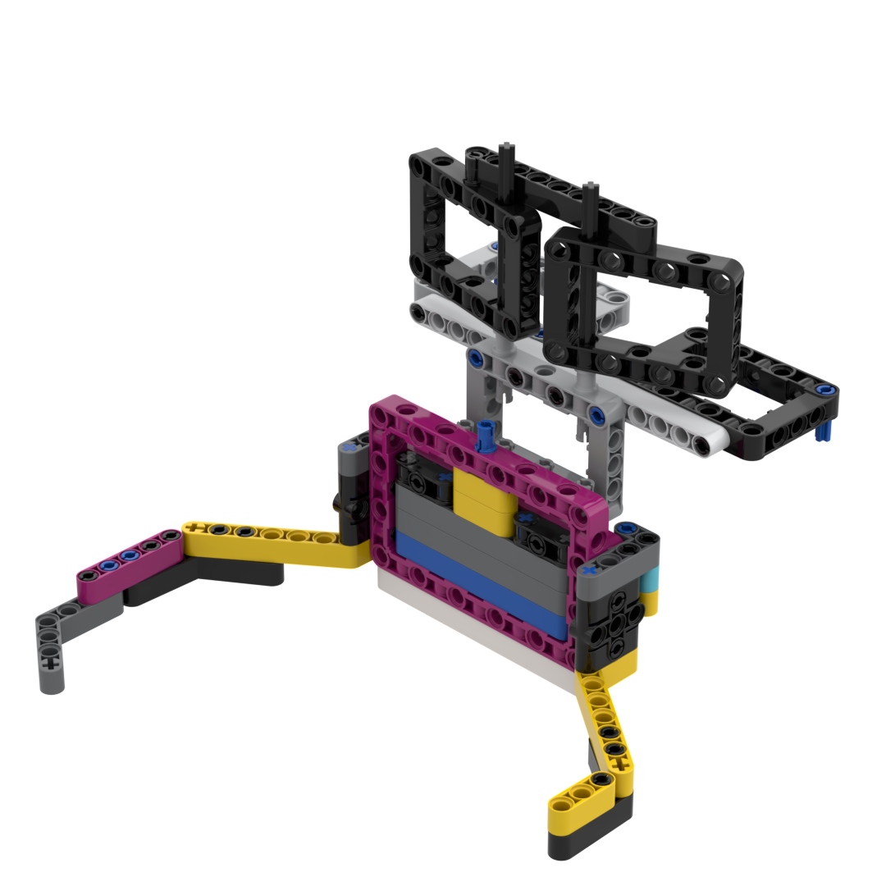
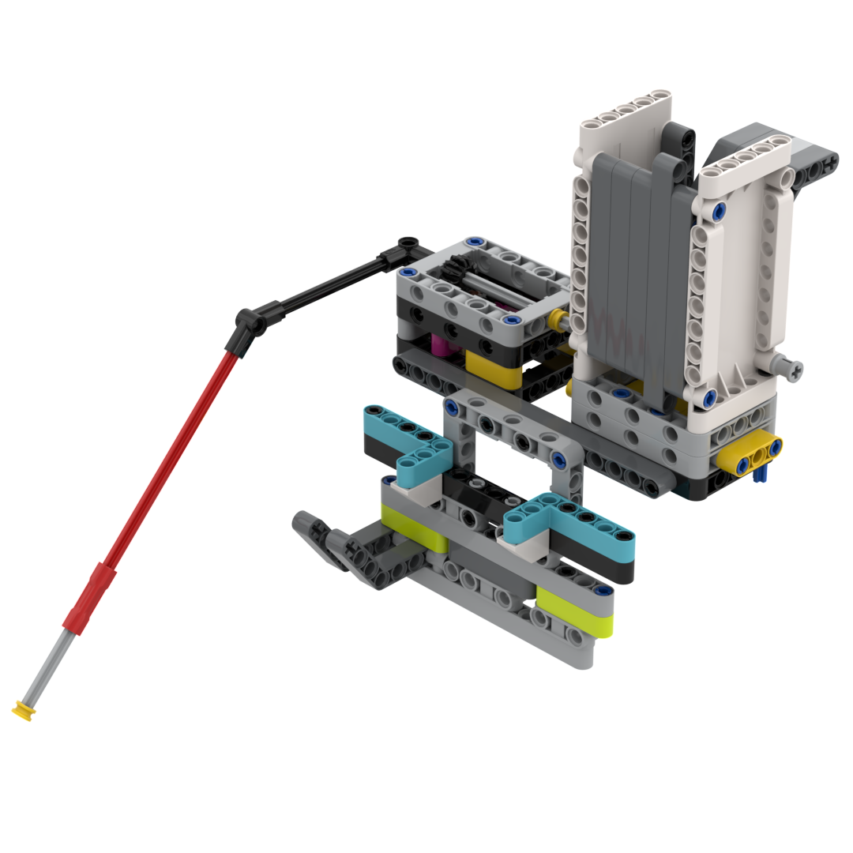
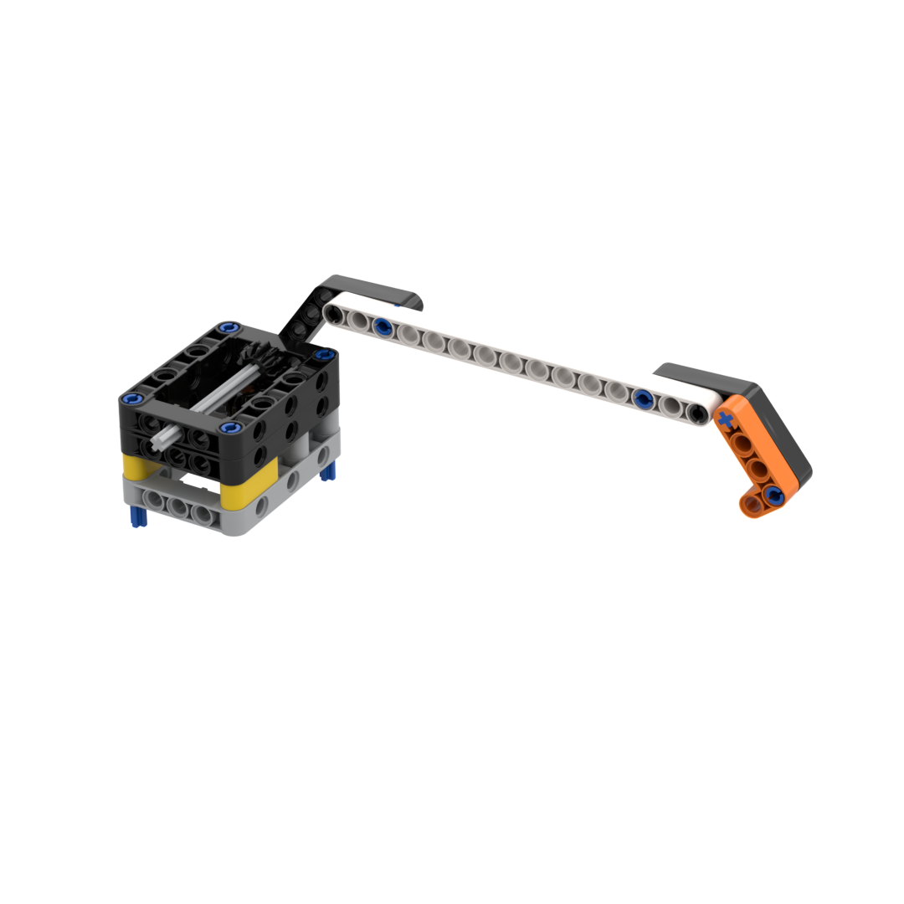
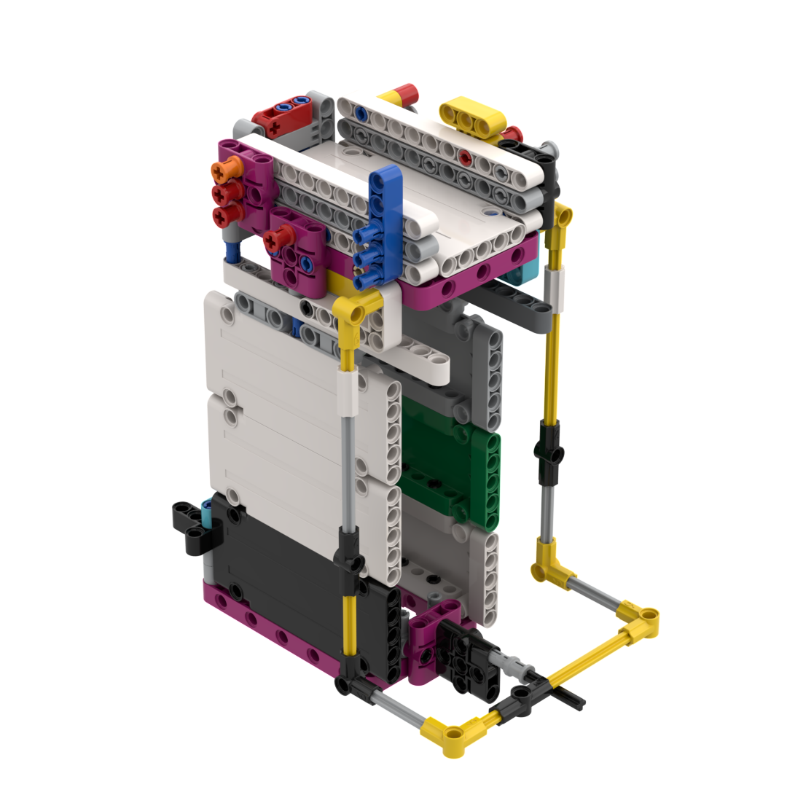
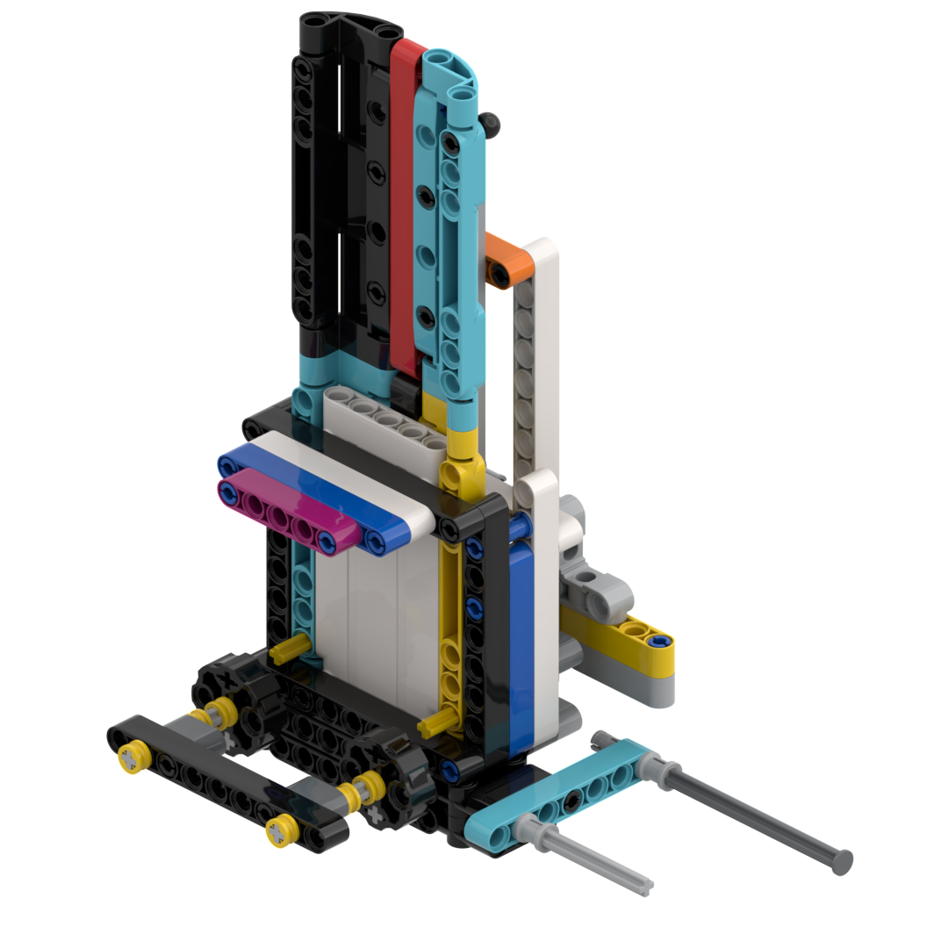
Build
Build attachments to complete each mission
What missions can be done by similar attachments?
Can a mission be solved passively (without using a motor)?
Try fit all tools for each run onto a standard drop-on connector
Throughout the year, we found we have been overcomplicating some attachments, so most of the time simple is best - CarWasher is a good example
Run 1 - Changing Shipping Lanes
Run 2 - Krill / Coral and Anglerfish
Run 3 - Coral Nursery / Reef and Shark
Run 4 - Radar and Plankton Sample
Run 5 - Whale
Run 6 - Submarine and Unknown Sea Creature

Slide 6
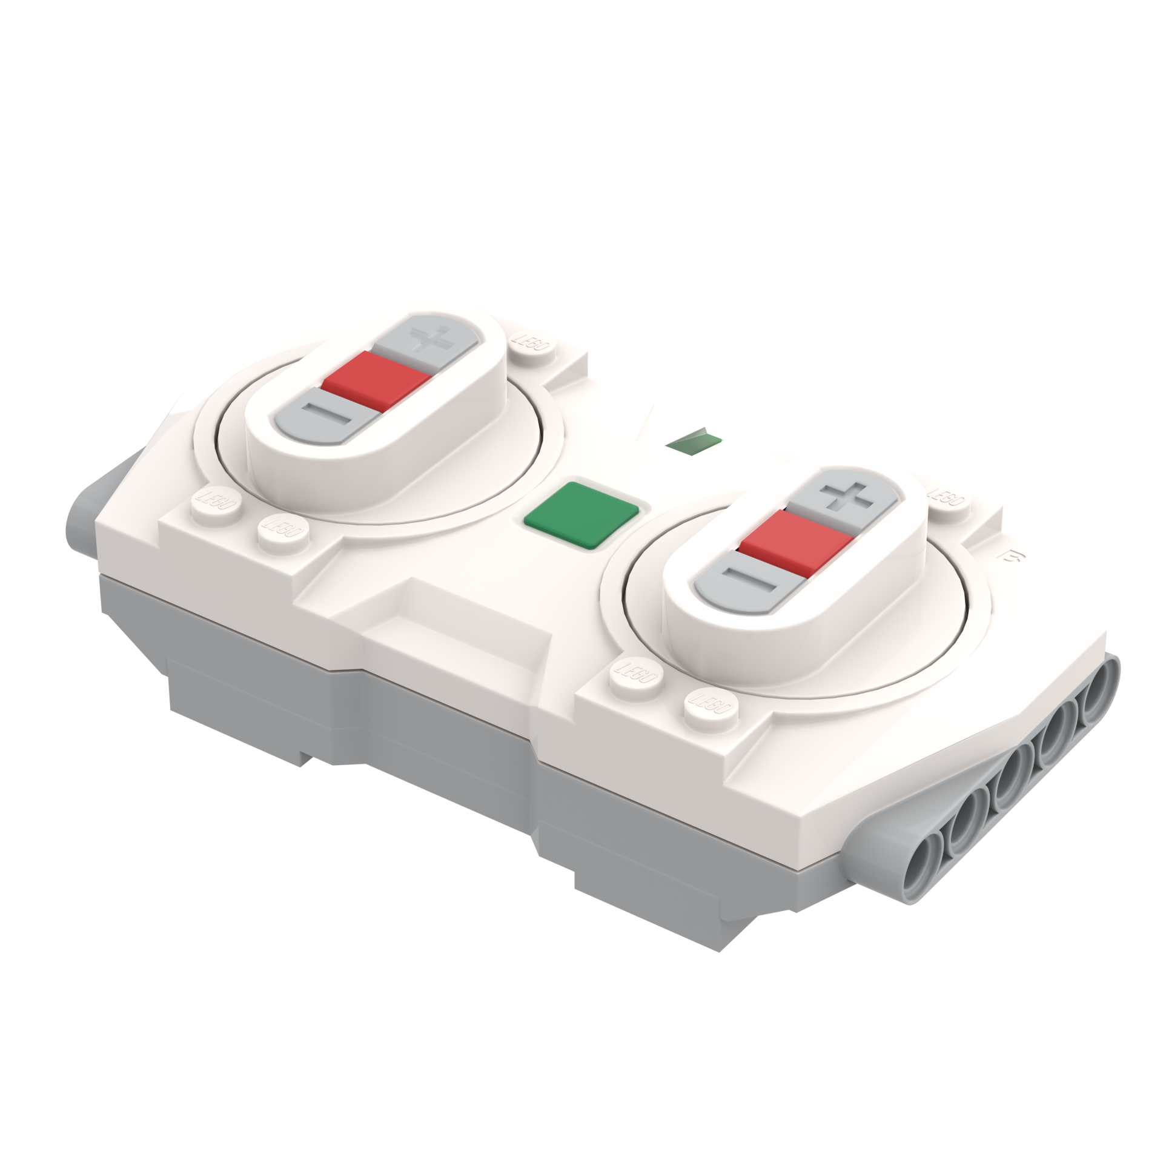

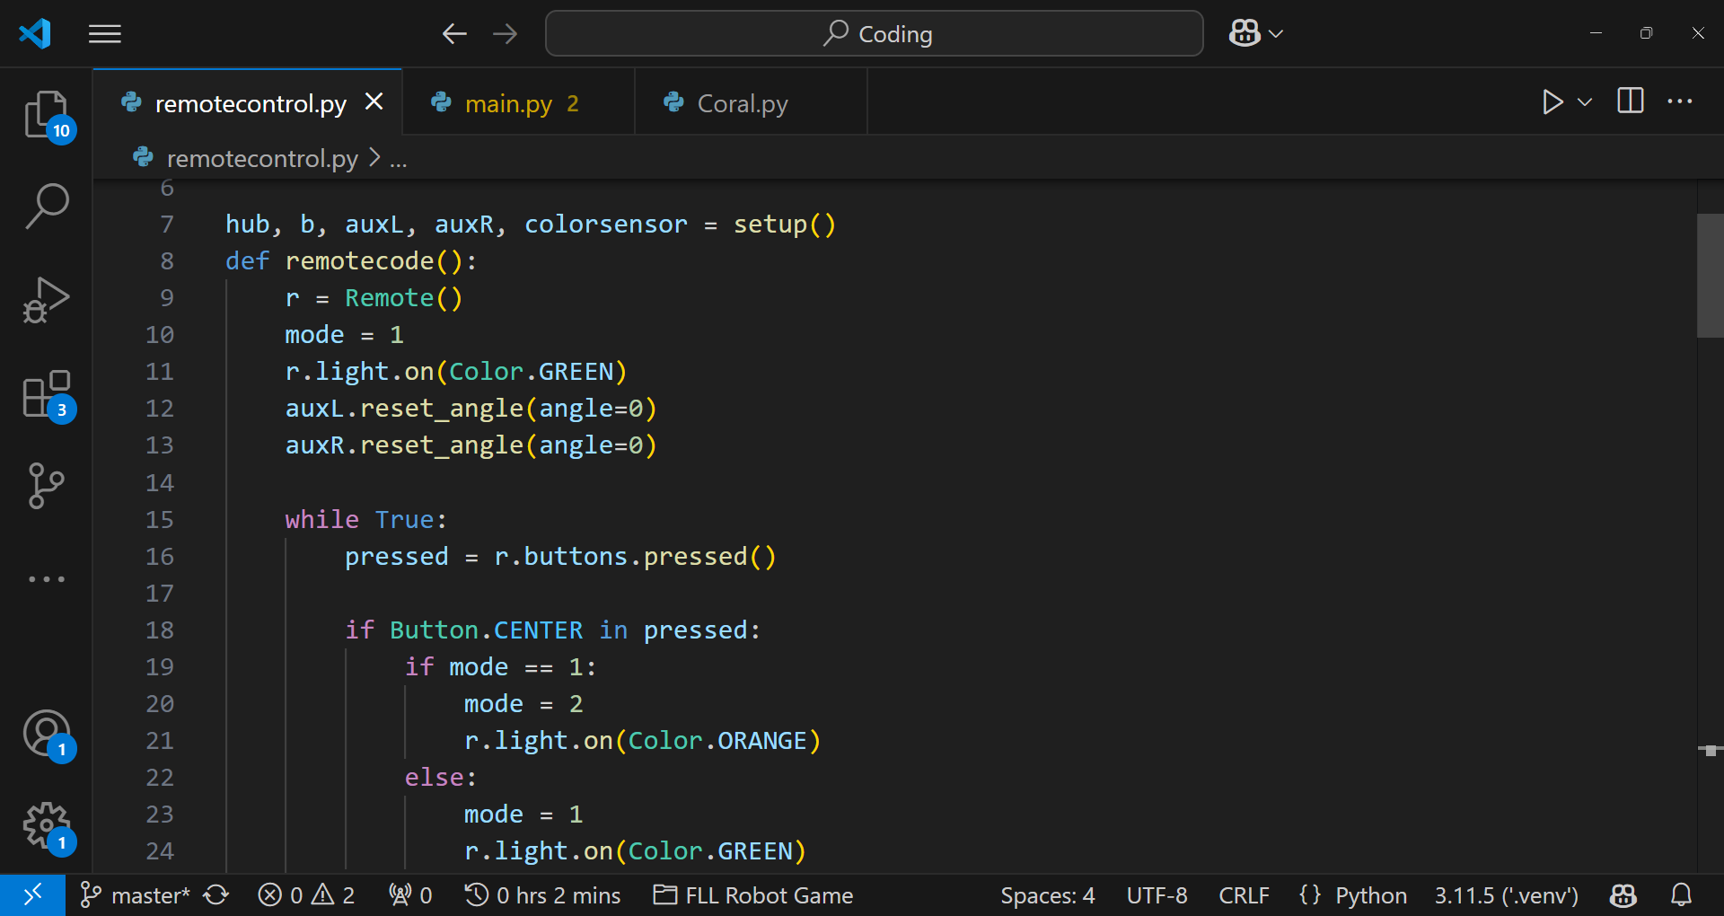
Drive
Use remote control to code the robot more quickly
Using Pybricks and remote control:
Connect robot to laptop and run code
Drive/turn desired distance
Press red button to send distance to computer
Copy code into program
Repeat for all movements in the run
Notes:
Using the Pybricks firmware, we have far more options in terms of advanced features. One of these is the ability to use a Powered Up remote control to drive the robot. It also allows us to measure how far the robot has driven or turned. We combined these features using Python code, allowing us to drive the robot, sending distances and turn angles back to the computer, which can then be input into the code. Usually, this is very accurate and dramatically increases our efficiency.

Slide 7


Adjust
Edit the code for maximum accuracy and consistency
We used an iterative coding process to code the robot, running the code, then editing it and running it again. Using the remote was not 100% accurate to what we wanted every time, so code improvement actually took up the majority of our time. On our third run, completing the Coral Reef, Shark and coral nursery, we completely restarted coding it at least 4 times (in a single week).

Slide 8


Pybricks
Spike
Harder to use but far more customisable and accurate
Easier for beginners and no complicated install
Python-based
Built-in gyro support
Allows use of remote control to drive robot without coding it
Simultaneous movements
Turns / straight line distances accurate
Much more powerful - allows you to change things Spike dreams of doing
Tricky to install
Steep learning curve in terms of coding the entire system
Default software / firmware package
Blocks based
Easy to learn
Built-in menu system
Very hard to backup codes / share code to other devices
No gyro support by default
Can’t import code from other runs / setup scripts

Slide 9
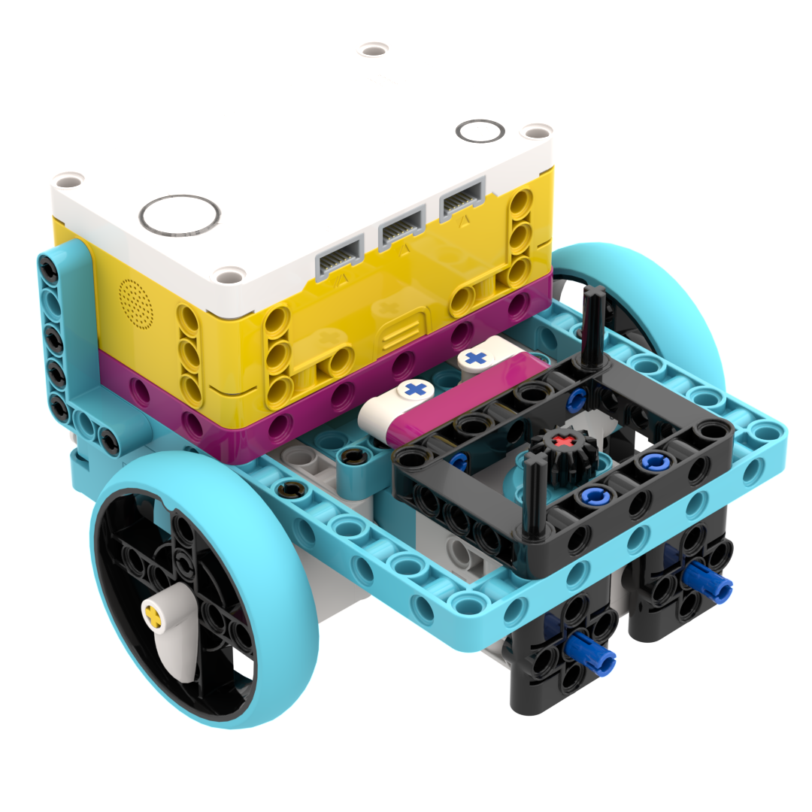
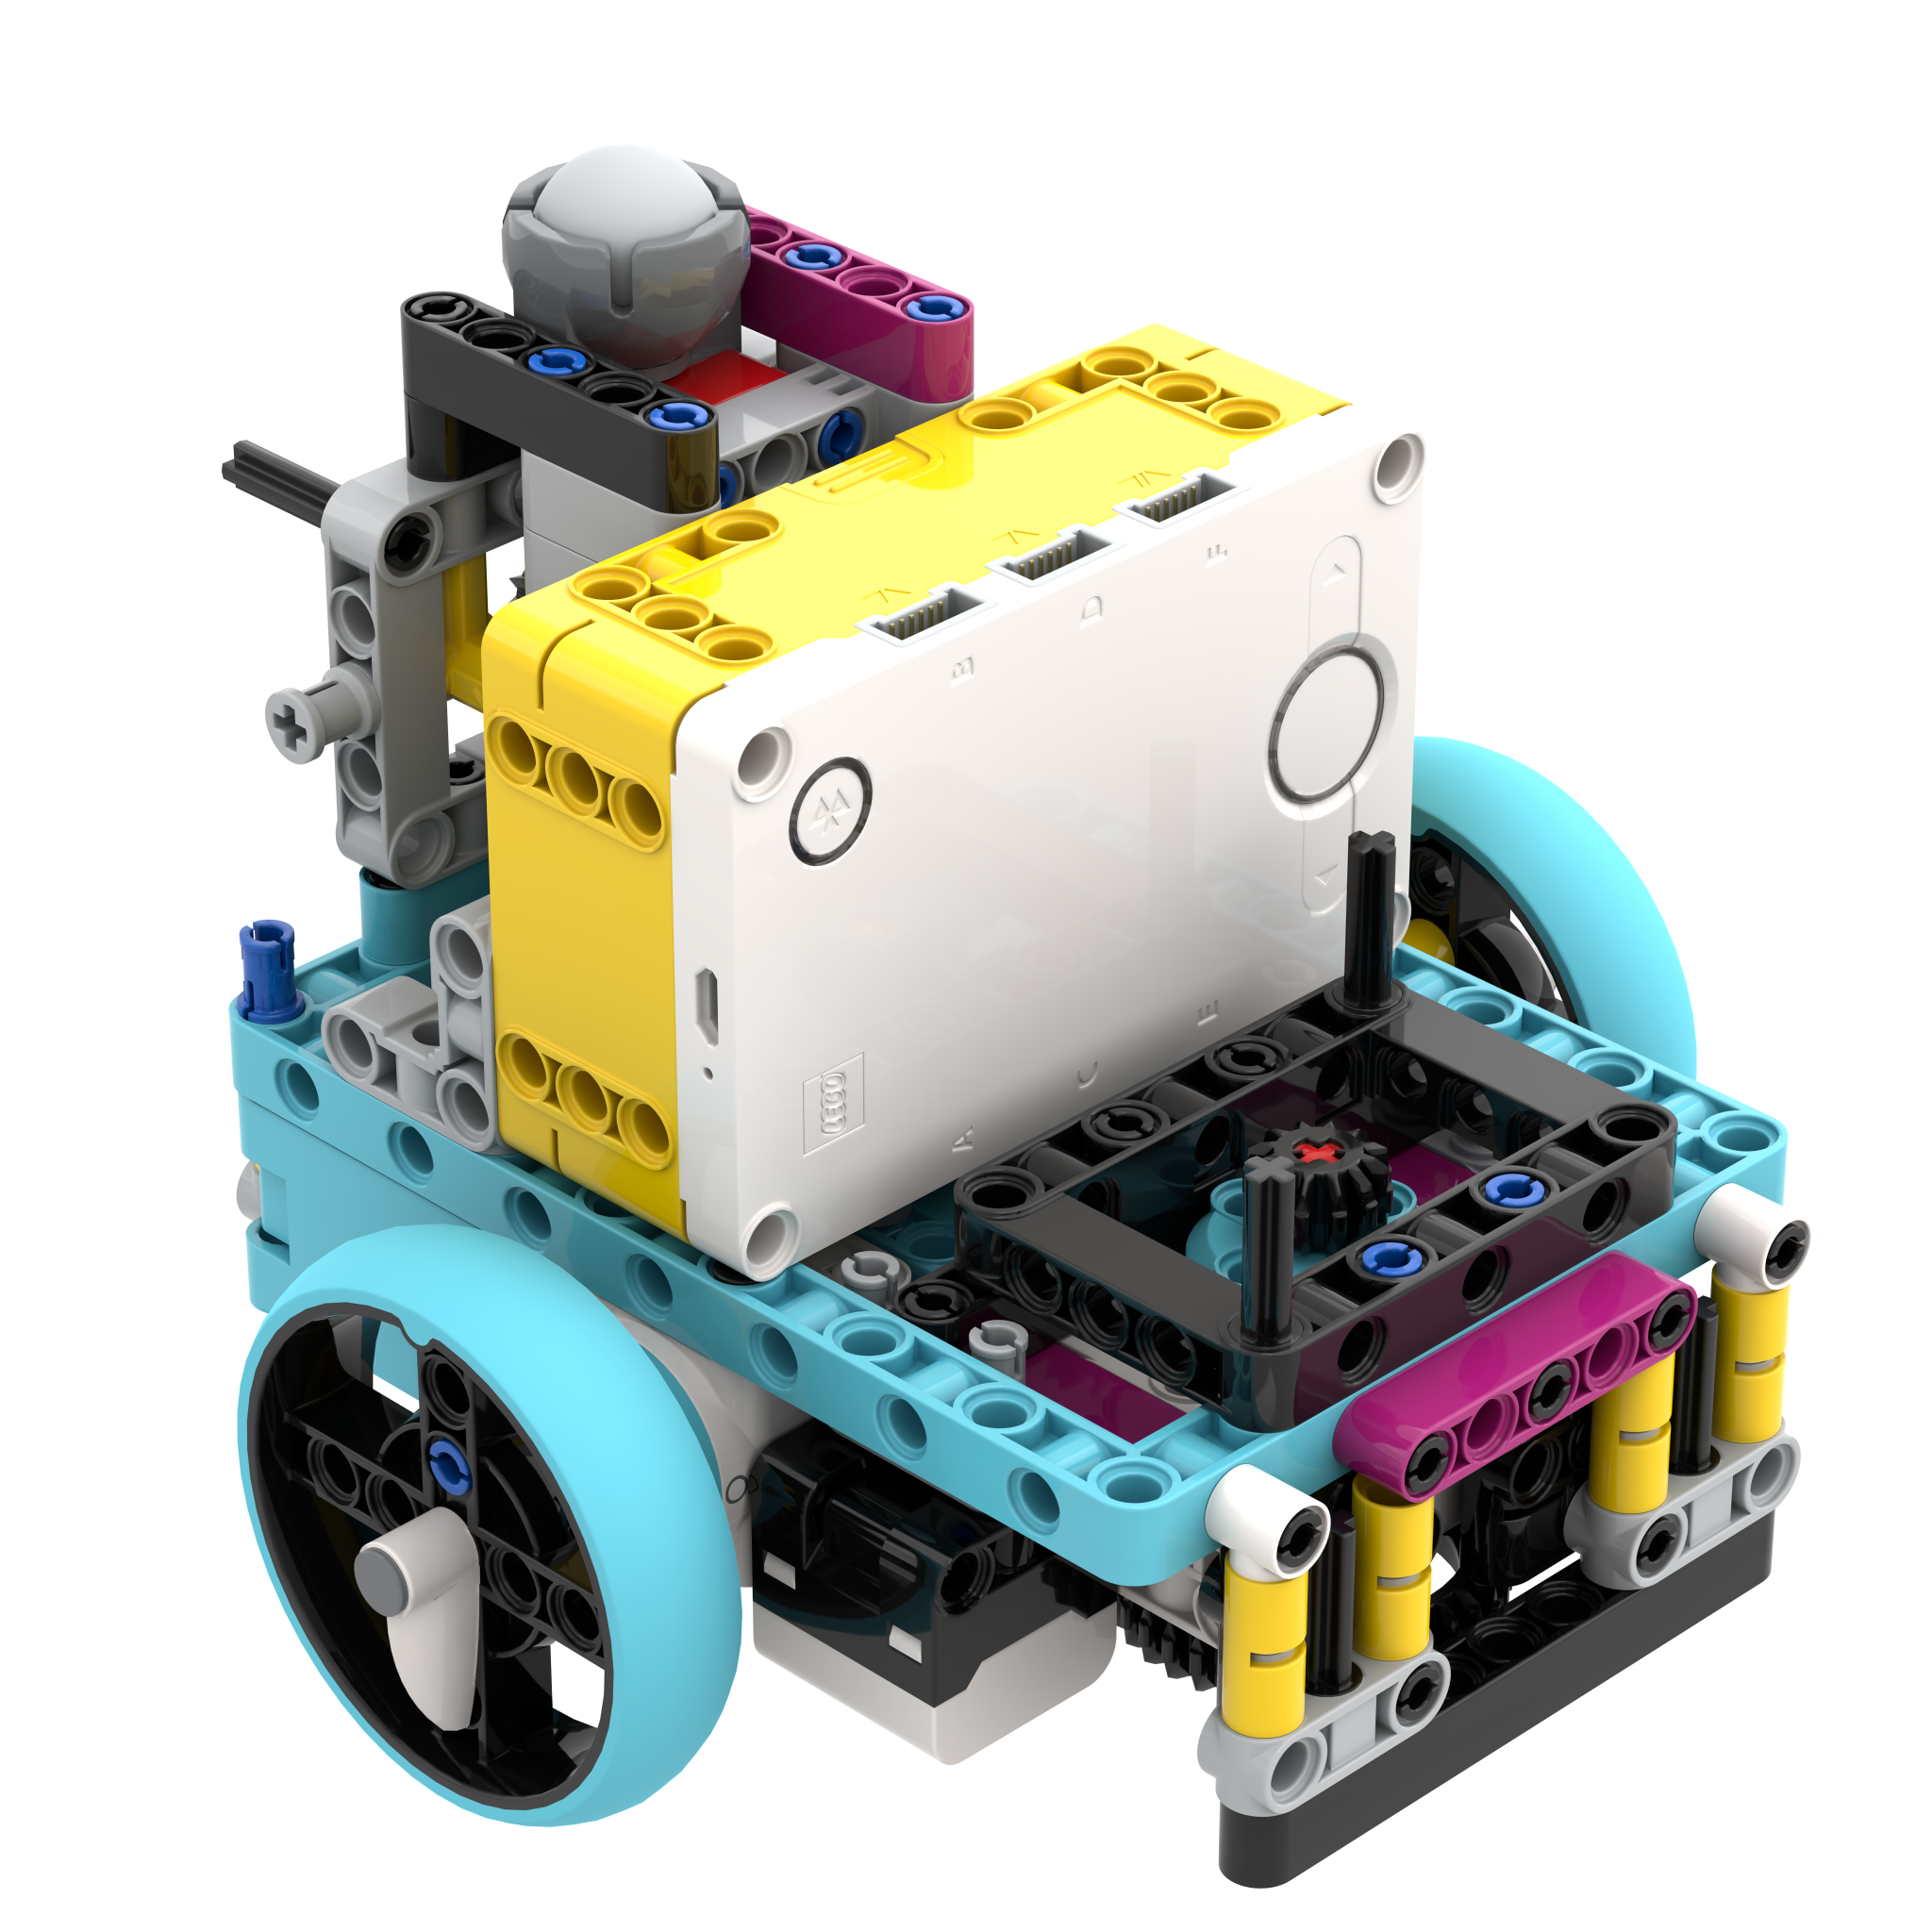
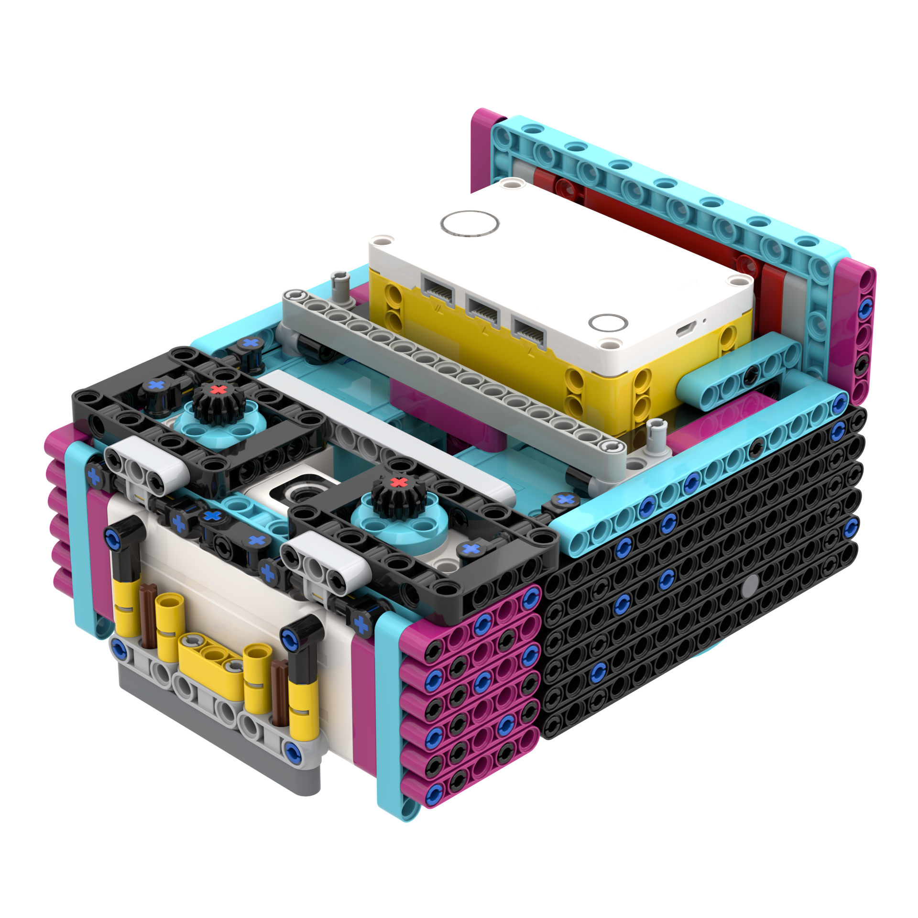
Robot Development
2023
2024
2025
Our first Spike Prime robot, not very stable and only one attachment motor
Much bigger robot but still had stability issues and sensors ended up not being usable
In our opinion, this is our best robot yet, with much improved connectors and body shape

Slide 10
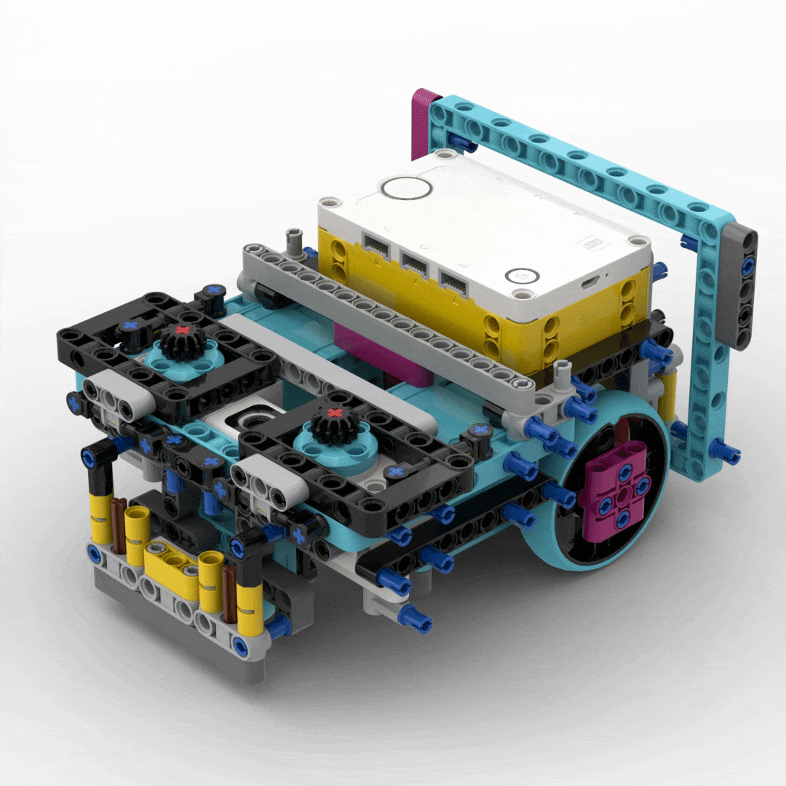
Our Robot
Design Constraints, developed over the last 4 years:
Dual front motors
Wheels / Ball wheel far from centre
Hub at back and facing upwards
As much weight near wheels as possible
Squared off flat sides for easy setup
Passive / active connection system
Optional:
Colour sensor to detect attachment
Drop-on attachments
Slipless active motor attachment - not implemented as we could not figure out how to

Slide 11


Slide 12
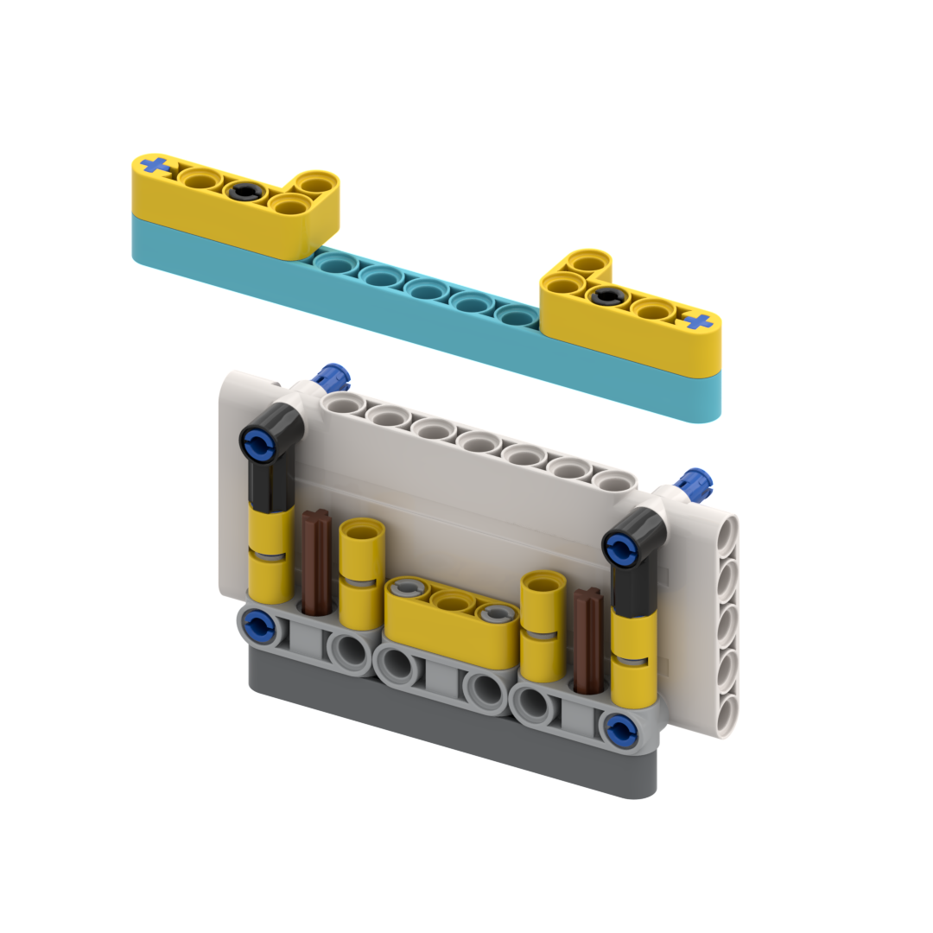
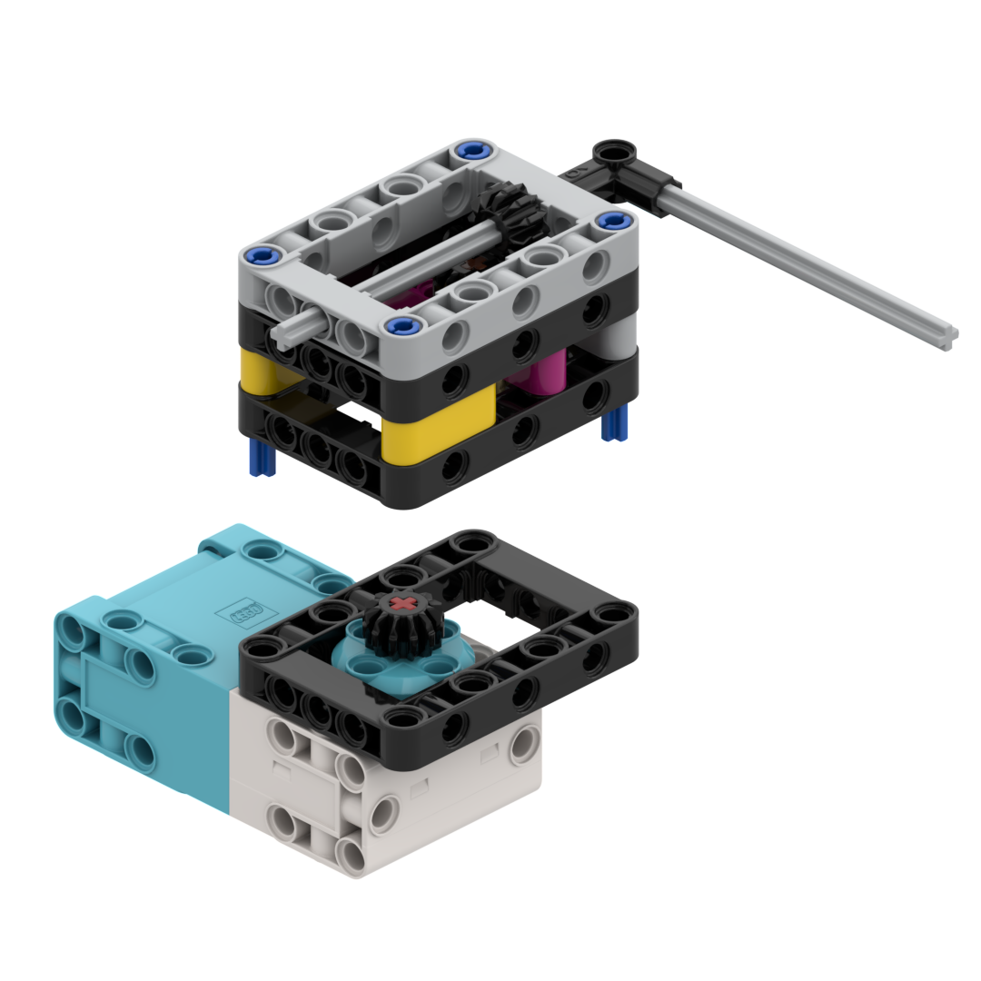
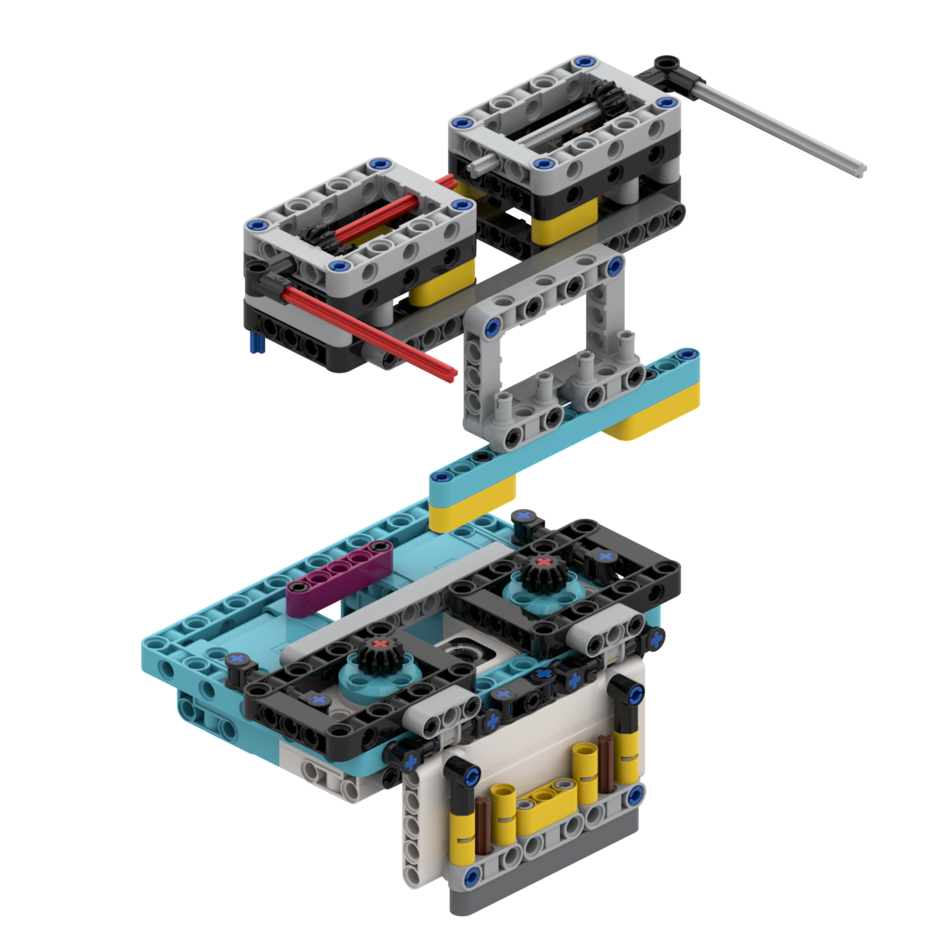
Connectors
Passive Connector
Active Connector
Our passive connector is used for attachments that don't require a motor on both the front and back of the robot
Motor-powered attachments use this for a fast, drop on connector. Last year we had issues with gears slipping, so this new gearbox design helps combat this.
Notes:
This year, we designed our robot around the motors and connection systems. We wanted two motors at the front as previously we did not use a rear motor. The passive and active attachment systems can also be combined to make a strong and reliable attacher.ear, we designed our robot around the motors and connection systems. We wanted two motors at the front as previously we did not use a rear motor. The passive and active attachment systems can also be combined to make a strong and reliable attacher.

Slide 13
Run 1 - Banana Boat
Uses a trigger release system with a rubber band for power
It activates when the red bar is pushed inwards upon contact with the mission
The grey bars then swing upwards in an arc, completing the mission
Notes:
Darragh

Slide 14
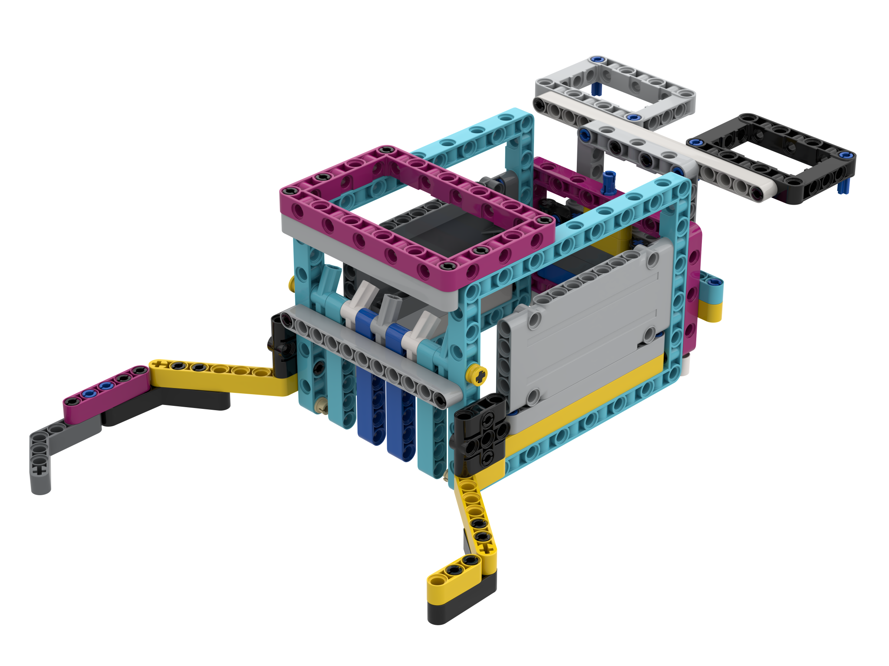
Run 2 - Krill
Goes from one side of the board to the other, collecting the 4 krill, water sample, and 3 coral
It also does the Unknown Sea Creature and the Anglerfish mission on the way
This clears the board, allowing us to drive freely to do the other missions
Used to be the very over complicated and large Carwasher, but we simplified it immensely

Slide 15
Run 3 - Shark
This launches from the Left Home, after the Krill run
Put 4 Krill and the octopus into the rectangular chute on the arm for use in later runs launching from the right side
This goes all the way around the board and does the Coral Nursery, The Shark, Raising the Mast and Collecting the Seabed Sample

Slide 16
Run 4 - Radar
We partially complete the radar as the second Whale is only worth 10 points and we are limited in time, scoring more points if we leave it
Then collect the Plankton Sample
This type of “long arm” has been used in all of SMGS FLL games since 2020, evolving with the games

Slide 17
Run 5 - Whale
We will put the Krill obtained in Run 2 and transported in Run 3
We proceed to the Whale and dump the Krill into the Whales mouth

Slide 18
Run 6 - Submarine
Using our rubber band powered passive attachment, we put the Octopus into the deep sea, utilising the prongs on the side.
We then turn towards the submarine and aggressively drive into it, triggering the attachment and sending the Submarine across the board to the other team

Slide 19
Planned / Unfinished Runs
Boat Run
Diver Run
Artificial habitat
The plan was to put the collected samples into the boat, it is coded and we have an arm built for it however we realistically do not have time at the end of the game to complete it.
We tried to catch the diver whilst pushing in the coral nursery, push the shark, put the diver on the hook and collect the seabed sample. However the arm was not stable enough to be accurate. This became the Shark Run.
We had built an arm to do the Artificial Habitat. It would work but we realised it would take too long to code and would be very hard to get it 100% accurate. We realised we needed to prioritise our time and ultimately decided to not do the artificial habitat.

